Slide 1


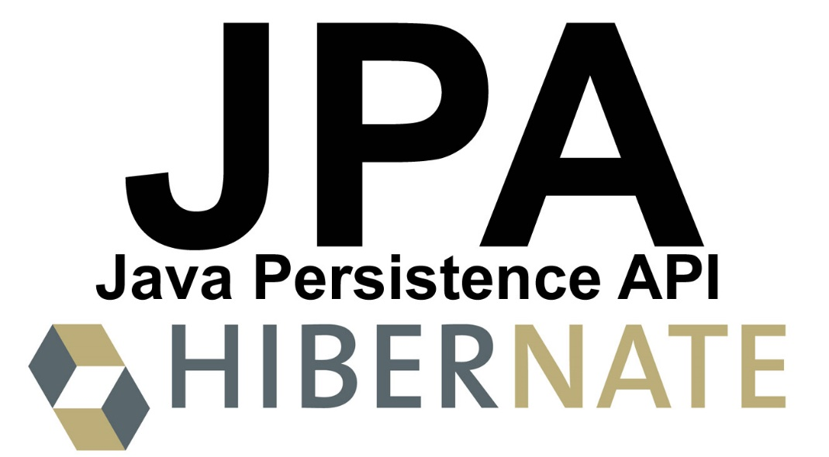

Hibernate Introduction
Maven, ORM, Hibernate, Configuration, JPA, Annotations
Hibernate
Introduction
SoftUni Team
SoftUni Team
Technical Trainers
Technical Trainers
Software University
Software University
http://softuni.bg

Slide 2

Table of Contents
Maven – as project management tools, managing dependencies
ORM – mapping Entities to DB relations
Hibernate – open source ORM provider (JPA implementation)
Configuration – how to configure persistence unit
JPA – API for different persistence ORM providers
Annotations – meta data used by frameworks
via reflection

Slide 3
Questions
sli.do #db-advanced

Slide 4

Maven

Slide 5
Maven basics
What is Maven used for?
Builds
Documentation
Reporting
Dependencies
Releases
Distribution

Slide 6
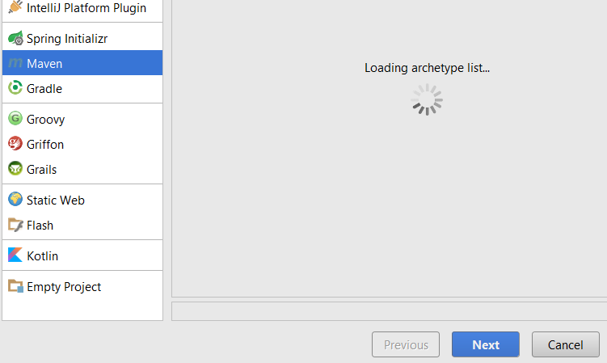
Setup
Maven project

Slide 7
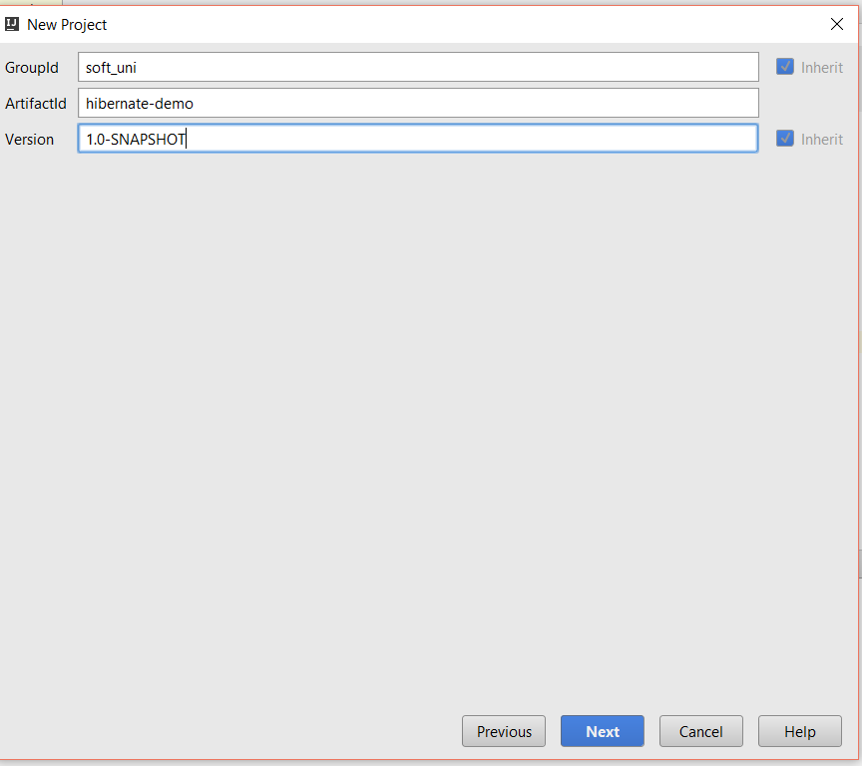
Setup
Project group
Current project
Version

Slide 8
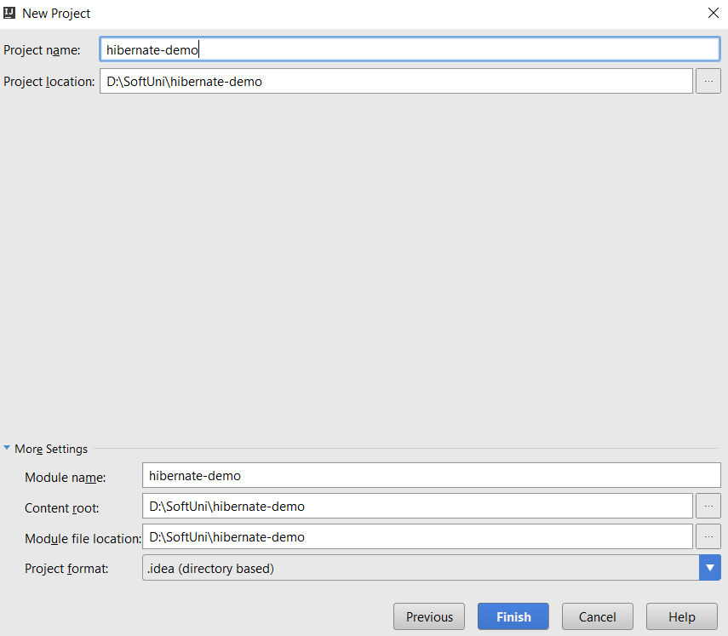
Setup

Slide 9
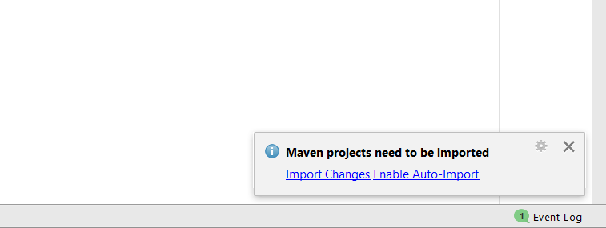
Setup
Auto-Import

Slide 10
Build
pom.xml
<build>
<plugins>
<plugin>
<groupId>org.apache.maven.plugins</groupId>
<artifactId>maven-compiler-plugin</artifactId>
<version>3.5.1</version>
<configuration>
<source>1.8</source>
<target>1.8</target>
</configuration>
</plugin>
</plugins>
</build>
Java compile version

Slide 11
Dependencies
pom.xml
<dependencies>
<dependency>
<groupId>org.hibernate</groupId>
<artifactId>hibernate-core</artifactId>
<version>5.2.3.Final</version>
</dependency>
<dependency>
<groupId>mysql</groupId>
<artifactId>mysql-connector-java</artifactId>
<version>6.0.4</version>
</dependency>
</dependencies>
Dependency 1
Dependency 2

Slide 12
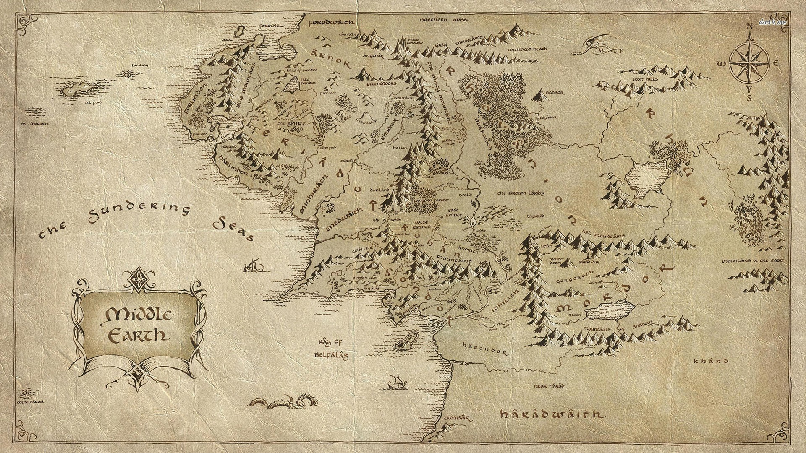
Hibernate

Slide 13
What is ORM?
In relational databases, business entities are represented as tables + relationships
In object-oriented languages, business entities are represented as classes
Object relational mapping frameworks (ORMs) are used for mapping business entities to database tables
OO
Programming
Language
ORM
Framework
Relational
Database

Slide 14




ORM – Concept
Student
id: int name: String birthDate: Date
ORM
Framework
students
id: INT name: VARCHAR(50) birth_date: Date

Slide 15
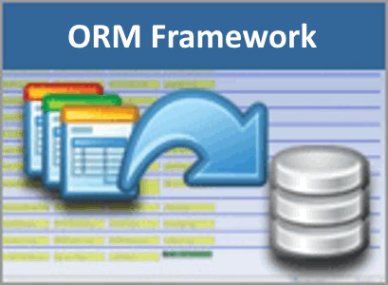
ORM Frameworks – Features
C# / Java / PHP classes are mapped to DB tables
DB relationships are mapped to class associations
ORM provides API for CRUD operations
List objects / query database
Create new object
Update existing object
Delete existing object
Some ORMs provide schema synchronization (DB migrations)
CRUD operations execute
SQL commands in the DB

Slide 16




JPA vs Hibernate
Couple 1
Couple 2
Salsa Dance
Couple 3

Slide 17

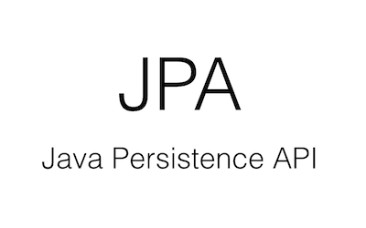


JPA vs Hibernate
Hibernate
EclipseLink
JPA
TopLink

Slide 18
Java ORM Approaches
Different approaches to Java ORM:
POJO (Plain Old Java Objects) + XML mappings
A bit old-fashioned, but very powerful
Implemented in the "classical" Hibernate
Annotated Java classes (POJO) mapped to DB tables
The modern approach, based on Java annotations
Easier to implement and maintain
Code generation
A tool generates classes based on some ORM / persistence framework

Slide 19
Hibernate Implementation
POJO (Plain Old Java Objects) + XML mappings
public class Student {
private int id;
private String name;
private Date registrationDate;
public int getId() { … }
public void setId(…) { … }
public int getName() …
public void setName() …
public int getDate() …
public void setDate() …
}
<hibernate-mapping>
<class name="entities.Student" table="students">
<id name="id" column="id">
<generator class="identity" />
</id>
<property name="name" column="first_name" />
<property name="registrationDate" column="registration_date"/>
</class>
</hibernate-mapping>

Slide 20
Hibernate configuration
pom.xml
<dependencies>
<dependency>
<groupId>org.hibernate</groupId>
<artifactId>hibernate-core</artifactId>
<version>5.2.3.Final</version>
</dependency>
<dependency>
<groupId>mysql</groupId>
<artifactId>mysql-connector-java</artifactId>
<version>6.0.4</version>
</dependency>
</dependencies>
Hibernate
MySQL connector
Notes:
<?xml version='1.0' encoding='utf-8'?> <!DOCTYPE hibernate-configuration PUBLIC "-//Hibernate/Hibernate Configuration DTD//EN" "http://www.hibernate.org/dtd/hibernate-configuration-3.0.dtd"> <hibernate-configuration> <session-factory> <property name="hibernate.dialect"> org.hibernate.dialect.MySQL5Dialect </property> <property name="hibernate.connection.driver_class"> com.mysql.jdbc.Driver </property> <!-- Connection Settings --> <property name="hibernate.connection.url"> jdbc:mysql://localhost:3306/school </property> <property name="hibernate.connection.username"> root </property> <property name="hibernate.connection.password"> 1234 </property> <property name="hbm2ddl.auto"> create </property> <!-- List of XML mapping files --> <mapping resource="Student.hbm.xml"/> </session-factory> </hibernate-configuration>

Slide 21
Hibernate configuration
hibernate.cfg.xml
<?xml version='1.0' encoding='utf-8'?>
<!DOCTYPE hibernate-configuration
PUBLIC "-//Hibernate/Hibernate Configuration DTD//EN"
"http://www.hibernate.org/dtd/hibernate-configuration-3.0.dtd">
<hibernate-configuration>
<session-factory>
<property name="hibernate.dialect">
org.hibernate.dialect.MySQL5Dialect
</property>
<property name="hibernate.connection.driver_class">
com.mysql.jdbc.Driver
</property>
Configuration
Dialect
Driver
Notes:
<?xml version='1.0' encoding='utf-8'?> <!DOCTYPE hibernate-configuration PUBLIC "-//Hibernate/Hibernate Configuration DTD//EN" "http://www.hibernate.org/dtd/hibernate-configuration-3.0.dtd"> <hibernate-configuration> <session-factory> <property name="hibernate.dialect"> org.hibernate.dialect.MySQL5Dialect </property> <property name="hibernate.connection.driver_class"> com.mysql.jdbc.Driver </property> <!-- Connection Settings --> <property name="hibernate.connection.url"> jdbc:mysql://localhost:3306/school </property> <property name="hibernate.connection.username"> root </property> <property name="hibernate.connection.password"> 1234 </property> <property name="hbm2ddl.auto"> create </property> <!-- List of XML mapping files --> <mapping resource="Student.hbm.xml"/> </session-factory> </hibernate-configuration>

Slide 22
Hibernate configuration
hibernate.cfg.xml
<!-- Connection Settings -->
<property name="hibernate.connection.url">
jdbc:mysql://localhost:3306/school
</property>
<property name="hibernate.connection.username">
root
</property>
<property name="hibernate.connection.password">
1234
</property>
<property name="hbm2ddl.auto">
create
</property>
DB URL
User
Pass
Auto strategy

Slide 23
Hibernate configuration
hibernate.cfg.xml
<!-- List of XML mapping files -->
<mapping resource=“student.hbm.xml"/>
</session-factory>
</hibernate-configuration>
Mappings

Slide 24
Hibernate mapping
student.hbm.xml
<?xml version="1.0" encoding="utf-8"?>
<!DOCTYPE hibernate-mapping PUBLIC
"-//Hibernate/Hibernate Mapping DTD//EN"
"http://www.hibernate.org/dtd/hibernate-mapping-3.0.dtd">
<hibernate-mapping>
<class name="entities.Student" table="students">
<id name="id" column="id">
<generator class="identity" />
</id>
<property name="name" column="first_name" />
<property name="registrationDate" column="registration_date"/>
</class>
</hibernate-mapping>
Mapping file
Class mapping
Field mapping
Field mapping
Field mapping

Slide 25
Hibernate sessions
Demo.java
public static void main(String[] args) {
Configuration cfg = new Configuration();
cfg.configure();
SessionFactory sessionFactory =
cfg.buildSessionFactory();
Session session = sessionFactory.openSession();
session.beginTransaction();
// Your Code Here
session.getTransaction().commit();
session.close();
}
Service Registry
Session
Transaction commit

Slide 26
Hibernate save data
Demo.java
public static void main(String[] args) {
//…
session.beginTransaction();
Student joro = new Student();
session.save(student);
session.getTransaction().commit();
session.close();
}
Save object

Slide 27
Hibernate retrieve data by Get
Demo.java
public static void main(String[] args) {
//…
session.beginTransaction();
Student student = (Student) session.get(Student.class, 1);
session.getTransaction().commit();
session.close();
}
Get object

Slide 28
Hibernate retrieve data by Query
Demo.java
public static void main(String[] args) {
//…
session.beginTransaction();
List<Student> studentList = session.createQuery("FROM Student ").list();
for (Student student : studentList) {
System.out.println(student.getId());
}
session.getTransaction().commit();
session.close();
}
Get list of objects

Slide 29
Hibernate Querying Language - HQL
SELECT
"FROM Student"
SELECT + WHERE
"FROM Student WHERE name = 'John'"
SELECT + JOIN
"FROM Student AS s
JOIN s.major AS major"

Slide 30
Hibernate retrieve data by Criteria
Demo.java
public static void main(String[] args) {
//…
session.beginTransaction();
List<Student> studentList = session.createCriteria(Student.class).list();
for (Student student : studentList) {
System.out.println(student.getId());
}
session.getTransaction().commit();
session.close();
}
Get list of objects

Slide 31

JPA

Slide 32
About JPA
What is Java Persistence API (JPA)?
Database persistence technology for Java (official standard)
Object-relational mapping (ORM) technology
Operates with POJO entities with annotations or XML mappings
Implemented by many ORM engines: Hibernate, EclipseLink, …
JPA maps Java classes to database tables
Maps relationships between tables as associations between classes
Provides CRUD functionality and queries
Create, read, update, delete + queries

Slide 33
Entities in JPA
A JPA entity is just a POJO class
Abstract or concrete top level Java class
Non-final fields/properties, no-arguments constructor
No required interfaces
Direct field or property-based access
Getter/setter can contain logic (e.g. validation)

Slide 34
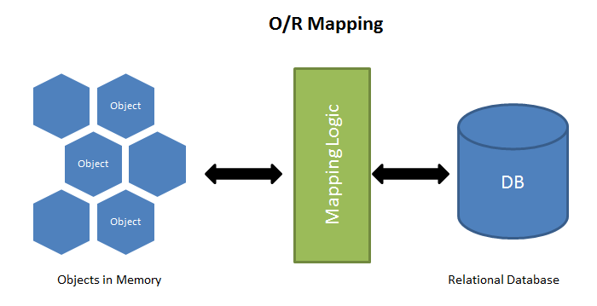
JPA – Overview
ORM Frameworks map OOP classes to database tables

Slide 35
Mapping DB Tables to Classes
ORM
Framework
Student
id: int name: String birthDate: Date
students
id: INT name: VARCHAR(50) birth_date: Date

Slide 36
Entity Class: Student
Student.java
@Entity @Table(name = "students")
public class Student {
@Id
@GeneratedValue(strategy = GenerationType.IDENTITY)
@Column(name = "id")
private int id;
@Column(name = "name", length = 50)
private String name;
@Column(name = “birth_date")
private Date birthDate;
}
Set table name
Primary key
Identity
Column name
Column name + length
Column name
Student
id: int name: String registrationDate: Date

Slide 37
Annotations
@Entity - Declares the class as an entity or a table.
@Table - Declares table name.
@Basic - Specifies non-constraint fields explicitly.
@Id - Specifies the property, use for identity (primary key of a table) of the class.
@GeneratedValue - Specifies how the identity attribute can be initialized such as automatic, manual, or value taken from a sequence table.
@Transient - Specifies the property that is not persistent, i.e., the value is never stored in the database.
@Column -Specifies the column attribute for the persistence property.

Slide 38
JPA configuration
pom.xml
<dependencies>
<dependency>
<groupId>org.hibernate</groupId>
<artifactId>hibernate-core</artifactId>
<version>5.2.2.Final</version>
</dependency>
<dependency>
<groupId>mysql</groupId>
<artifactId>mysql-connector-java</artifactId>
<version>6.0.4</version>
</dependency>
</dependencies>
JPA
MySQL Connector

Slide 39
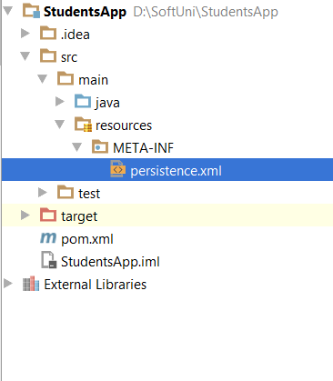
JPA Configuration

Slide 40
JPA Configuration
persistance.xml
<?xml version="1.0" encoding="UTF-8"?>
<persistence xmlns="http://java.sun.com/xml/ns/persistence" version="2.0">
<persistence-unit name="school">
<properties>
<property name = "hibernate.connection.url" value="jdbc:mysql://localhost:3306/school"/>
<property name = "hibernate.connection.driver_class" value="com.mysql.jdbc.Driver"/>
<property name = "hibernate.connection.username" value="root"/>
<property name = "hibernate.connection.password" value="1234"/>
<property name = "hibernate.dialect" value="org.hibernate.dialect.MySQL5Dialect"/>
<property name = "hibernate.hbm2ddl.auto" value="create"/>
<property name = "hibernate.show_sql" value = "true" />
</properties>
</persistence-unit>
</persistence>

Slide 41
JPA save objects
Demo.java
public static void main(String[] args) {
EntityManagerFactory emf = Persistence.createEntityManagerFactory("school");
EntityManager em = emf.createEntityManager();
em.getTransaction().begin();
Student student = new Student("Teo", new Date());
em.persist(student);
em.getTransaction().commit();
}
Save object

Slide 42

JPA – Java Persistence API
Persistence
import javax.persistence.*;
==
JPA
createEntityManagerFactory()
Query
EntityManagerFactory
setParameter()
getResultList()
getSingleResult()
executeUpdate()
Entity
Entity
Entity
createEntityManager()
id
field1
field2
id
field1
field2
id
field1
field2
EntityManager
EntityTransaction
getTransaction()
find() / createQuery()
persist()
remove()
begin()
commit()
rollback()

Slide 43
Persistence Context (PC) and Entities
Persistence Context
Application
EntityManager
MyEntity A
MyEntity C
MyEntity a
MyEntity B
MyEntity b
Entities
Entity state
Database

Slide 44
Entity object life cycle
new
persist
retrieve
New
Managed
DB
remove
persist
commit flush
clear, close
Detached
Removed

Slide 45
JPA write data methods
persist() – persists given entity object into the DB (SQL INSERT)
remove() – deletes given entity into the DB (SQL DELETE by PK)
refresh() – reloads given entity from the DB (SQL SELECT by PK)
detach() – removes the object from the PC
merge() – synchronize the state of detached entity with the PC
contains() - Determine if given entity is managed by the PC
flush() – writes the changes from PC in the database

Slide 46
JPA read data methods
find() - execute a simple Select query by PK
Demo.java
public static void main(String[] args) {
EntityManagerFactory emf = Persistence.createEntityManagerFactory("school");
EntityManager em = emf.createEntityManager();
em.getTransaction().begin();
em.find(Student.class,1)
em.getTransaction().commit();
}
Get object

Slide 47
JPA delete objects
Demo.java
public static void main(String[] args) {
EntityManagerFactory emf = Persistence.createEntityManagerFactory("school");
EntityManager em = emf.createEntityManager();
em.getTransaction().begin();
Student student = em.find(Student.class,1);
em.remove(student);
em.getTransaction().commit();
}
Remove object

Slide 48
JPA merge objects
Merges the state of detached entity into a managed copy of the detached entity
Returned entity has a different Java identity than the detached entity
May invoke SQL SELECT
public Student storeUpdatedStudent(Student student) {
return entityManager.merge(student);
}

Slide 49

Summary
Maven – as project management tools, managing dependencies
ORM – mapping Entities to DB relations
Hibernate – open source ORM provider (JPA implementation)
Configuration – how to configure persistence unit
JPA – API for different persistence ORM providers
Annotations – meta data used by frameworks
via reflection

Slide 50







Java OOP Fundamentals
https://softuni.bg/courses/databases-advanced-hibernate

Slide 51

License
This course (slides, examples, demos, videos, homework, etc.) is licensed under the "Creative Commons Attribution-NonCommercial-ShareAlike 4.0 International" license
Attribution: this work may contain portions from
"Databases" course by Telerik Academy under CC-BY-NC-SA license

Slide 52





Free Trainings @ Software University
Software University Foundation – softuni.org
Software University – High-Quality Education, Profession and Job for Software Developers
softuni.bg
Software University @ Facebook
facebook.com/SoftwareUniversity
Software University Forums
forum.softuni.bg

